Slide 1
FinSentinal – Financial Distress Early Warning System (FDEWS)
Name: SriVishnu Pejathaya
USN: 4SO24MC102
3rd Semester MCA
Dr Hareesh B
HOD-MCA

Slide 2
Introduction
Corporate financial distress can lead to severe economic losses for investors and institutions.
Early identification enables preventive actions and better risk management.
Traditional models rely on static financial ratios and lack transparency.
FinSentinal addresses these limitations using machine learning and explainable AI.

Slide 3
Background and Motivation
Increasing volatility in global markets increases financial risk.
Manual financial analysis is time-consuming and subjective.
Automated, data-driven prediction systems improve consistency and speed.
Need for interpretable AI systems in financial decision making

Slide 4
Abstract
FinSentinal is an AI-powered Financial Distress Early Warning System.
It predicts the probability of corporate financial distress using ML models.
Uses financial ratios and live market data.
Provides SHAP-based explanations for transparency.
Includes interactive dashboard and report generation.

Slide 5
Objectives
Predict financial distress at an early stage.
Compute a unified Financial Distress Index (FDI).
Apply Random Forest and XGBoost models.
Provide explainable predictions using SHAP.
Support real-time analysis using live financial data.

Slide 6
Features of the Project
FDI score computation
Risk classification (Healthy / Moderate / Distressed)
Live data integration (Yahoo Finance)
SHAP feature importance visualization
Interactive dashboard with charts and KPIs
PDF and CSV report export
Prediction history storage

Slide 7
Methodology
Data collection (sample + live data)
Data preprocessing and scaling
ML model training and inference
FDI score computation
Explainability using SHAP
Visualization via web dashboard

Slide 8
SRS: Introduction and Scope
Describes functional and non-functional requirements.
Serves as a reference for developers and evaluators.
Defines system behaviour and constraints.
Web-based financial distress prediction system.
Supports multiple companies.
Provides explainable AI insights.
Generates downloadable reports.

Slide 9
SRS: Users
Investors
Financial analysts
Researchers
Students
Risk management professionals

Slide 10
SRS: Operating Environment
Web browser interface
Flask backend server
SQLite database
Internet connection for live data

Slide 11
SRS: Functional Requirements
Select company and data source
Fetch financial data
Generate FDI score
Display risk category
Generate SHAP explanations
Store prediction history
Export reports

Slide 12
SRS: Non-Functional Requirements
Fast response time
High usability
Reliable predictions
Modular architecture
Secure API communication

Slide 13
LITERATURE REVIEW
Altman Z-Score, Ohlson O-Score
Logistic regression models
Random Forest, SVM, XGBoost
Explainable AI: SHAP, LIME
Research gap: lack of transparency and real-time support

Slide 14
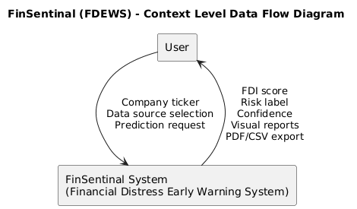
Diagram (Context Flow Diagram)

Slide 15
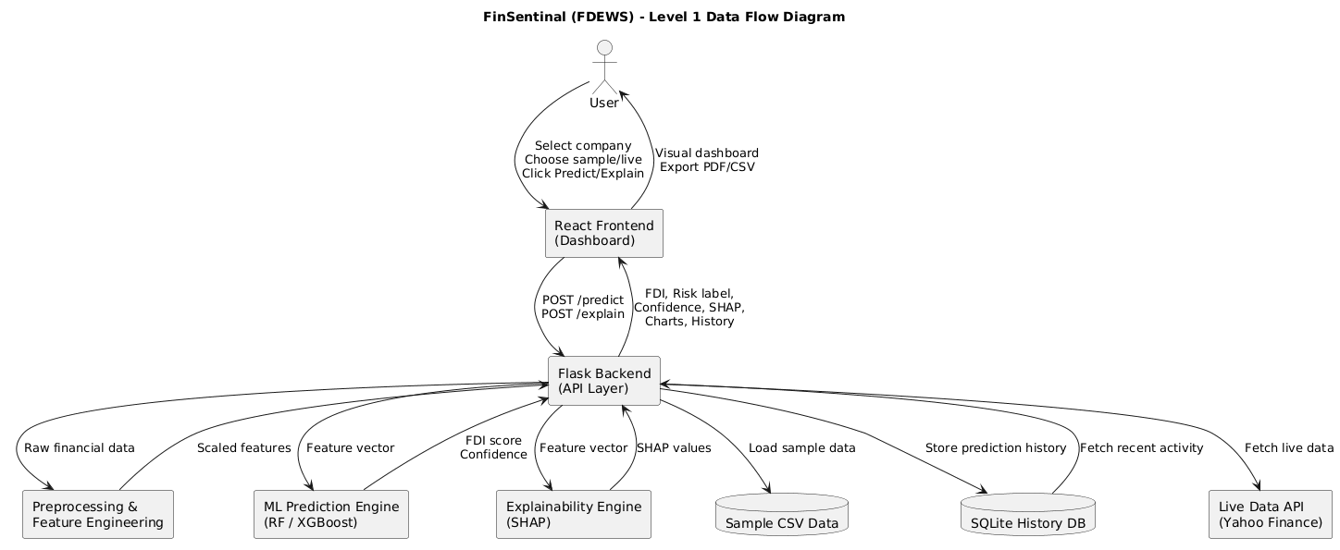
Diagram (Level 1 DFD)

Slide 16
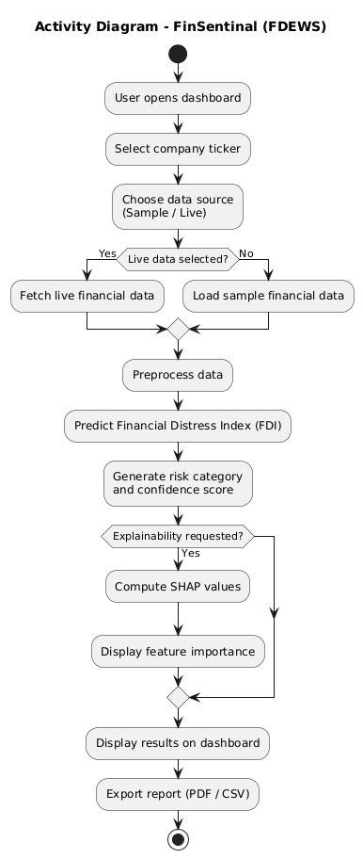
Activity Diagram

Slide 17
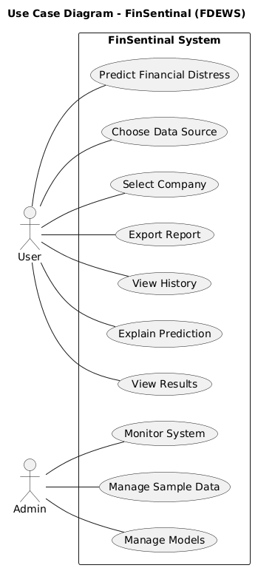
Diagram (Use Case Diagram)

Slide 18
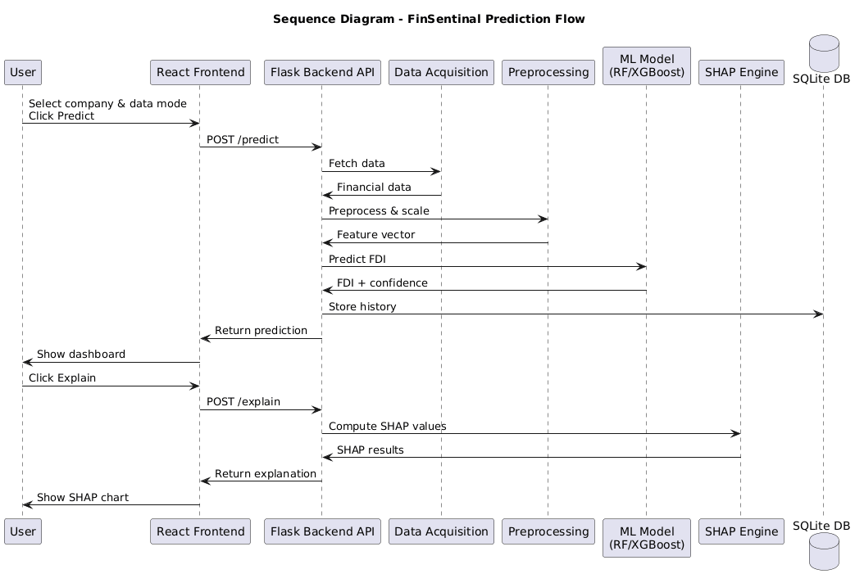
Diagram (Sequence diagram)

Slide 19
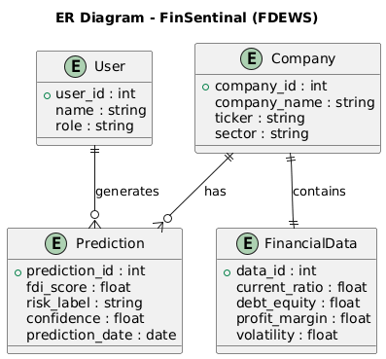
Diagram (ER Diagram)

Slide 20
TESTING
Unit testing of backend modules
API testing
System testing using sample data
Validation using performance metrics

Slide 21
Implementation: Technology Stack
Frontend: React, Chart.js
Backend: Flask, Python
ML: Random Forest, XGBoost
Explainability: SHAP
Database: SQLite

Slide 22
Implementation: Prediction Algorithm
Input financial features
Data preprocessing
Model inference
FDI score generation
Risk classification

Slide 23
Implementation: Explainability Module
SHAP TreeExplainer initialization
Feature contribution calculation
Ranking of top features
Visualization on dashboard

Slide 24
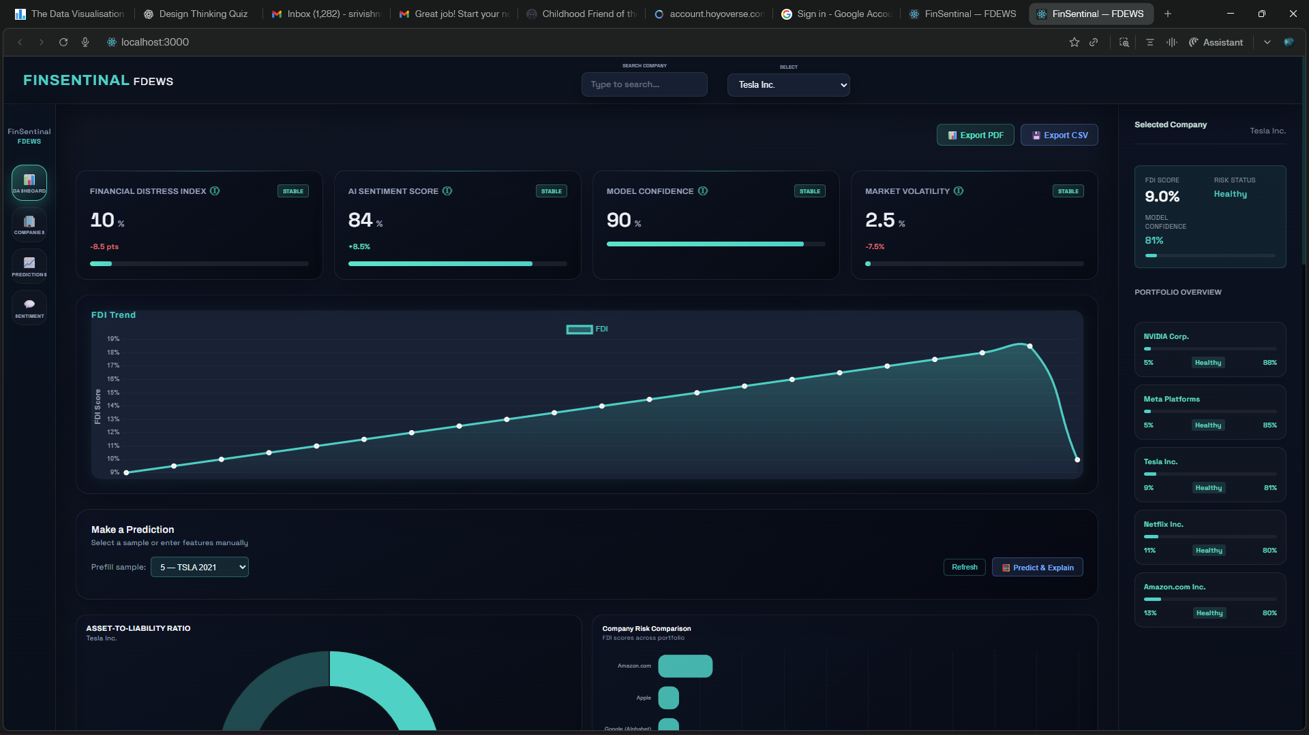
Screenshot (Dashboard)

Slide 25
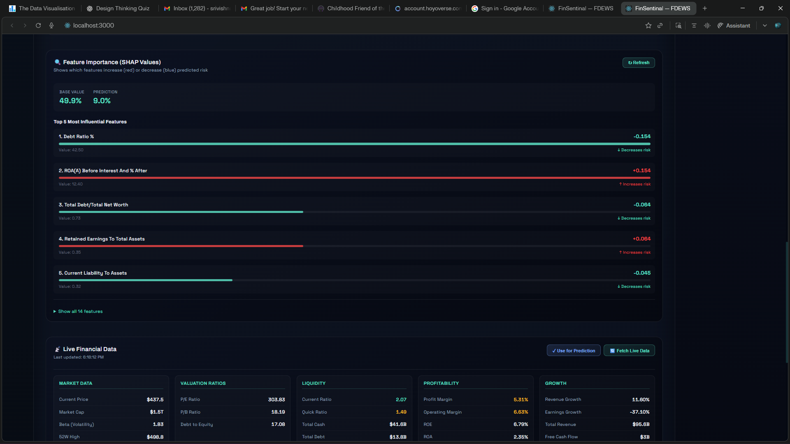
Screenshot (SHAP Feature Importance)

Slide 26
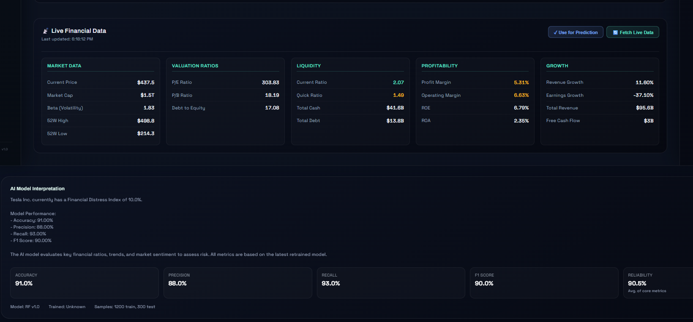
Screenshot (Live data panel)

Slide 27
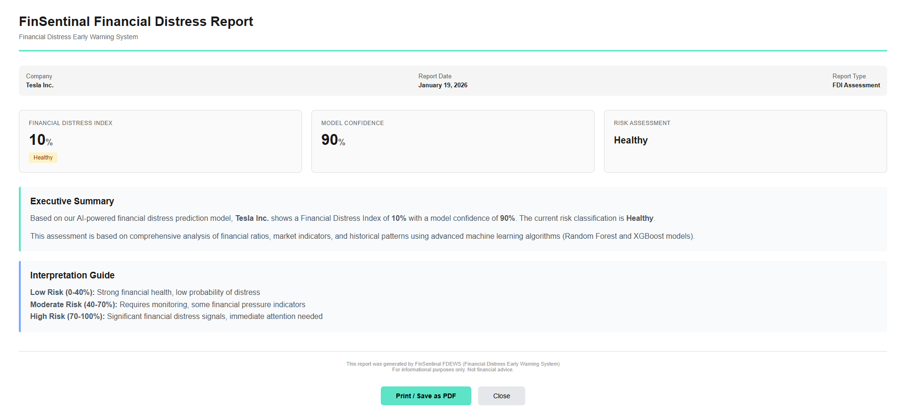
Screenshot (Prediction Report (PDF)

Slide 28
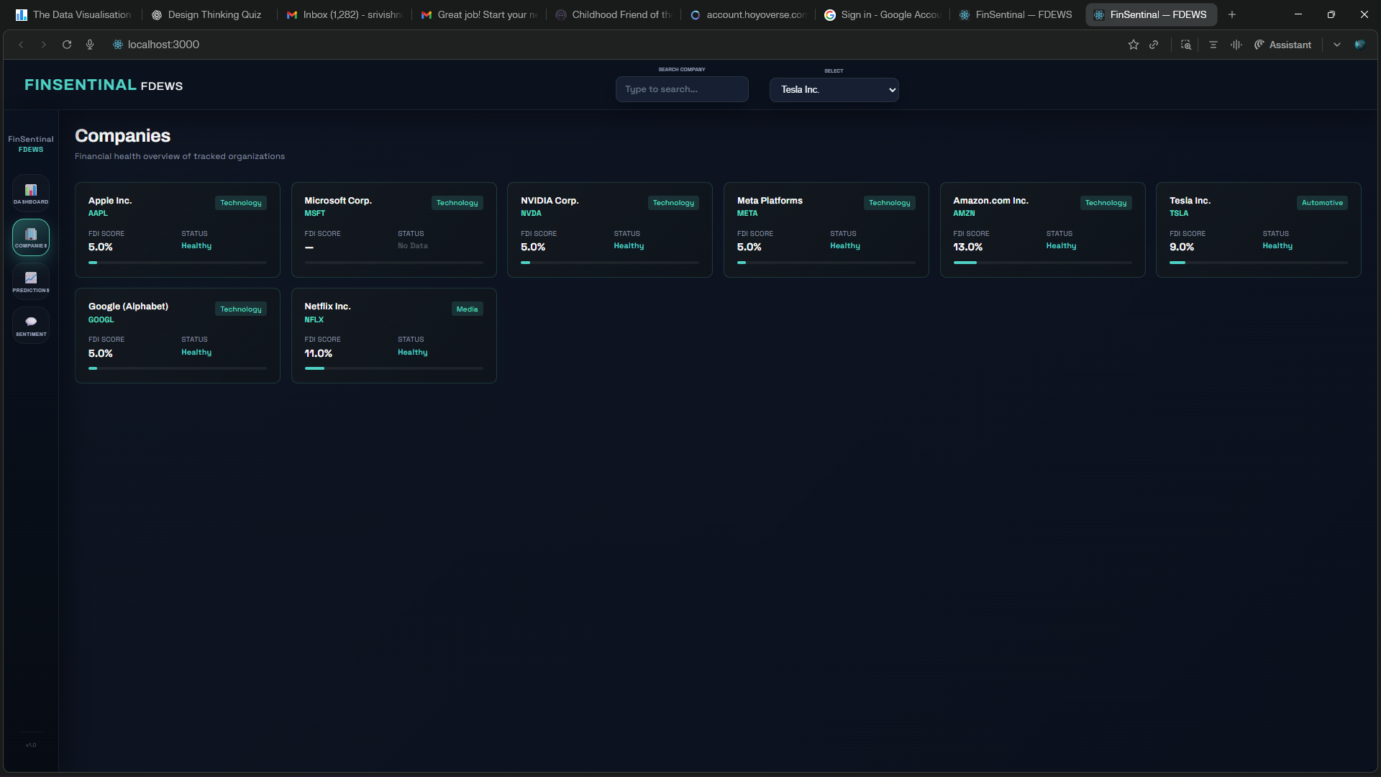
Screenshot (Companies overview)

Slide 29
Conclusion
FinSentinal achieves early distress prediction
Combines ML, explainability, and visualization
Demonstrates feasibility of AI-based financial risk systems
Provides foundation for future expansion

Slide 30
THANK YOU

